Slide 1
LET’S GET INSPIRED!
ART IN ENGLISH
Parini Primary School Cassano Magnago 1^ A-B-C
Teacher Giorgia Zanatto

Slide 2
1ST LOOK

Slide 3
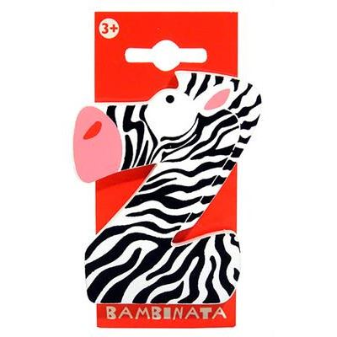
2ND TURN Z INTO A ZEBRA

Slide 4
3RD LOOK AT THIS ETHNIC AFRICAN PAINTING AND CREATE A LANDSCAPE FOR YOUR ZEBRA

Slide 6
4TH CUT YOUR ZEBRA AND STICK IN ON THE LANDSCAPE

Slide 7
OURS ZEBRAS

Slide 8
OURS ZEBRAS

Slide 9
OURS ZEBRAS

Slide 10
OURS ZEBRAS

Slide 11
OURS ZEBRAS

Slide 12
OURS ZEBRAS

Slide 13
Sitography The images have been used for non-profit educational purposes
Page 2
https://static.kodami.it/wp-content/uploads/sites/31/2021/01/iStock-483230252-638x425.jpg
Page 3
https://images.cdn3.stockunlimited.net/preview1300/letter-z-for-zebra_1236525.jpg
https://i.ytimg.com/vi/HfpXUx3ONdo/maxresdefault.jpg
https://zambiasi.progettiarchimede.it/data/LV_FOTO/miniature/7392.jpg
Pages 4-5
https://static.bimago.pl/mediacache/catalog/product/cache/0/1/49310/image/750x1120/30427754acdb7a49ecebd10effc788eb/49310_1.jpg
Page 6
Self-adaptation of images on pages 3, 5 and 6 with Paint

